Slide 1
Web Design Fundamentals /
Basic Web Design
Introduction to HTML and HTML Tags – ITEWEBDES/ITWD103 / ITWD113

Slide 2
TERM DEFINITION
HTML – Hypertext Markup Language, a programming specification for how web pages can be written so they can be understood.
Notes:
HTML is not a programming language. The "M" stands for "Markup". Generally, a programming language allows you to describe some sort of process of doing something, whereas HTML is a way of adding context and structure to text.

Slide 3
TERM DEFINITION
XML – Extensible Markup Language, a specification that grew out of HTML that lets developers define their own markup language like <name> <city> which is an element created by developers

Slide 4
History of HTML
SGML (Standard Generalized Markup Language)
The first version of HTML introduced in 1980.
CERN under Tim Berners-Lee announced that WWW would be free on April 30, 1993.
Notes:
HTML is an application conforming to International Standard ISO 8879 -- Standard Generalized Markup Language (SGML). SGML is a system for defining structured document types, and markup languages to represent instances of those document types.
CERN, short for Conseil Europeen pour le Recherche Nucleaire (European Laboratory for Particle Physics), is a world renowned research center located in Geneva, Switzerland.
CERN is where Sir Tim Berners-Lee first developed the theory of HTML and the Web as a working prototype.

Slide 5
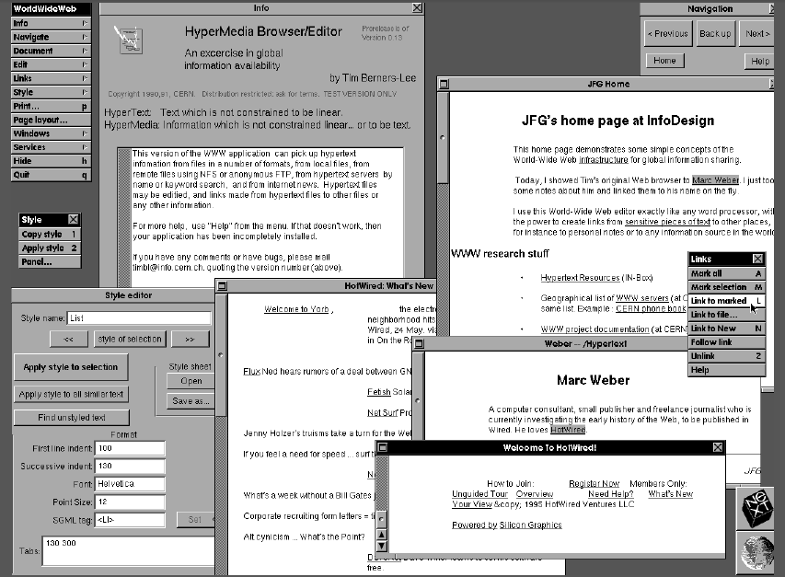
A copy of the original website by Tim Berners-Lee appeared in 1991.
Notes:
The first web browser - or browser-editor rather - was called WorldWideWeb as, after all, when it was written in 1990 it was the only way to see the web. Much later it was renamed Nexus in order to save confusion between the program and the abstract information space (which is now spelled World Wide Web with spaces).

Slide 6
Versions of HTML
HTML 1.1 – Release date was 1992, first informal draft
HTML 2.0 – used the official standard of HTML, 1995. Documents written in 2.0 can still be viewed in all browsers
HTML 3.2 – the most common used standard supported by all browser version (1996/97)
HTML 4.0 – is the suggested standard introduced by W3-Consortium, which is supported by newer browser. (1997/98)

Slide 7
Versions of HTML
HTML 4.1 – introduced in 1999, W3C Recommendation
XHTML 1.0 – reformulate HTML 4.01 W3C Recommendation on 2000
HTML 5 – introduced in 2008, introduced new features like <nav> <header> <footer> <figure>

Slide 8
XHTML
a. It is supposed to replaced HTML.
It is nearly identical to HTML 4.01
It has a stricter and cleanly version of HTML
Disadvantages:
1. Web developers have to obey the rules.
2. Errors will not be tolerated.
3. More expenditure of time.

Slide 9
W3C
The World Wide Web Consortium
The W3C is the main international standard organization which was created by Tim Berners-Lee
Well known members are:
IBM Microsoft
America Online Apple
Adobe Sun Microsystem

Slide 10
Getting Started
with HTML Syntax

Slide 11
Choosing an HTML Editor
Three ways to create HTML
Code-based editor
WYSIWYG ( What You See Is What You Get) editor
Simple text editor
Windows
Notepad
Macintosh
TextEdit

Slide 12
Good Coding Practices
Stick to the standards – follow the standards set by the W3C
Use semantic markup – use a descriptive markup that signifies the intended use of document sections, <p> paragraph
Validate your code – this conforms to the usage rules of the W3C, this is to enhance browser compatibility, accessibility, and exchange of data

Slide 13
Important Key Terms
Cascading Style Sheets (CSS)
Cookie
Deprecated element
Document Type (doctype)
Document Type Definition (DTD)
Extensible Hypertext Markup Language (XHTML)
Hypertext
Hypertext Markup Language
Markup language
Metadata
Multipurpose Internet Mail Extensions (MIME)
Rendering engine
Root element
Semantic markup
Single-source
Standard Generalized Markup Language (SGML)
Style sheet
18. Valid code
19. Validator
20. Web page
21. Well-formed document
22. World Wide Web Consortium (W3C)

Slide 14
Hands-on Instructions
It is recommended that for now, the students will use notepad as their HTML editor.
B. Create a folder in your drive H, foldername: itwebdes_section
C. For now, all the samples will be viewed in Google Chrome. Your professor will be showing you the other output in other browser.

Slide 15
Each web page has four basic tag sets:
Tag | Closing | Description
<html> | </html> | Defines the area within as an HTML page.
<head> | </head> | Contains information about the document.
<title> | </title> | Identifies the title of the page, contained within the <head> tag.
<body> | </body> | Surrounds the text of the page.

Slide 16
OPEN NOTEPAD and type the following:
<html>
</html>
<html>
<head>
<title>Page Title Goes Here </title>
</head>
</html>
BASIC WEB PAGE TAGS
Save file.
Filename: sample1.htm

Slide 17
Add the body content.
<html>
<head>
<title>Page Title Goes Here</title>
</head>
<body>
Page content
<br>
goes here.
</body>
</html>

Slide 18
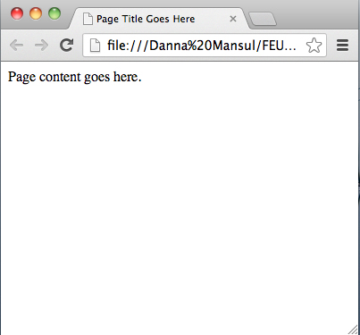

Slide 19
WEB FONTS
WEB FONTS
Basics

Slide 20
Selecting desired fonts for your website
Serif / Sans Serif
Times New Roman
Georgia
Garamond
Helvetica
Arial
Trebuchet
Notes:
Monospace
Cursive
Fantasy

Slide 21
What font style do you want?
Serif / Sans Serif
Convey:
Warm, personal, artistic, traditional, conservative, or intellectual
Convey:
Technical, cool, clean, crisp, youthful, modern, uncluttered
Notes:
Monospace
Cursive
Fantasy

Slide 22
TEXT COLORS
Deciding with the help of KULER
TEXT CONTENT
TEXT CONTENT
TEXT CONTENT
Complementary Colors
Triad Colors
Notes:
Colors can grab attention, change the mood and change emotions.

Slide 23
Choosing the Right Color
Contrast
Harmony
Branding
Web Design Standards
Cultural Differences
Reference to WixBlog

Slide 24
HTML markup takes the form of TAGS
<tag>Marked up text</tag>
Some of these tags have attributes
<tag attribute=“value”>Text</tag>
Some tags have opening and closing elements, while some have just opening
<center><img src=“image.gif”></center>

Slide 25
Browsers ignore multiple spaces, spacing only once unless told otherwise. &nbsp;
Browsers do not know when to start new paragraphs or break at the end of lines. <p> </p>
- Browsers do not know how you wish to format text.

Slide 26
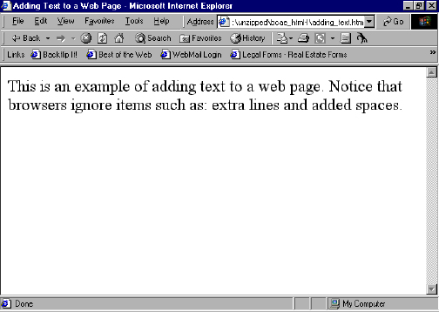
Sample Output

Slide 27
Paragraph
The <p> tag tells the browser to insert a new paragraph.
The closing tag for this (</p>) is optional, but recommended.

Slide 28
Line Breaks
To insert a line break, use the <br> tag. Note, that this tag has no closing tag.
Ex. ‘Hello<br>World’:
Hello World

Slide 29
Text Spacing
&nbsp;
This is the non-breaking space character, and adds the ability to have extra spaces to your page.
Ex.: ‘There are 3 spaces between this and this.’:
<p>There are 3 spaces between &nbsp;&nbsp;and this.</p>

Slide 30
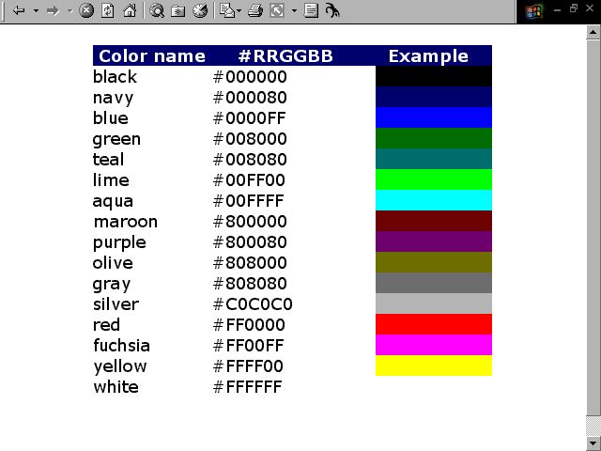
Basic web colors

Slide 31
Attributes
<body attribute=“” > </body>
bgcolor – the page’s background color.
background – the page’s background image.
text – the default color of all the page’s text.
link – the default color for all links.
alink – the default color for all default links.
vlink – the default color for all visited links.

Slide 32
Headings
Heading tags are <h1> to <h6>.
Each has an opening and closing tag
<h1> has the largest font, and <h6> the smallest.
<h4> - <h6> are actually smaller than your normal text font and should be used sparingly.

Slide 33
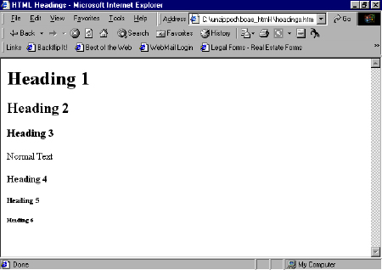

Slide 34
Basic Text Formatting Tags
Tag | Closing | Description
<b> | </b> | Creates bold text.
<i> | </i> | Creates italicized text.
<u> | </u> | Underlines text (use with caution).
<big> | </big> | Big text. Can be overlapped (a bigger big).
<small> | </small> | Small text. Can be overlapped (a smaller small).

Slide 35
End of Module

